Slide 1

NMCAA Board of Directors Board Orientation
Kerry Baughman
Executive Director
FY2022

Slide 2
Agenda
I. BRIEF HISTORY
II. NMCAA BOARD OF DIRECTORS
III. NMCAA OVERVIEW
IV. NMCAA OPERATIONS PLANS/ROMA
V. THE PRESENT AND THE FUTURE…

Slide 3
I. BRIEF HISTORY

Slide 4
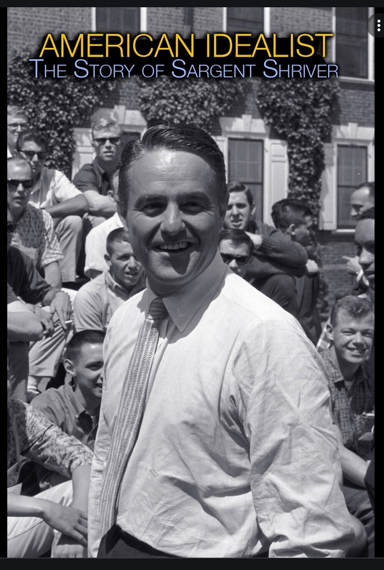
The origin of Community Action was the enactment of the Economic Opportunity Act of 1964, with the primary purpose of the Community Action Agency (CAA) to provide a local mechanism through which communities work to determine the best approaches to solving the problems of poverty, and act to bring together a wide range of Federal, State, and local resources to implement the approaches.

Slide 5


Slide 6
NMCAA: Part of a National Network
The Economic Opportunity Act & the creation of the Office of Economic Opportunity (1964 – 1974)
Community Services Administration
(1974 -1981)
Community Services Block Grant
(1981 – present)
Nearly 1,000 CAAs across the Country
National Community Action Partnership (NCAP)- National network
Notes:
OEO = closed by Gerald Ford in 1975. Placed within the Executive Office of the Johnson Administration
CSA = independent agency.
Office of Community Services= an office of the Administration of Children and Families within the U.S. DHHS. CSBG is one on the program of OCS.

Slide 7
NMCAA: Part of a State Network
Michigan Economic & Social Opportunity Act of 1981 (PA 230)
The Community Action & Economic Opportunity Act of 2003 (PA 123)
Bureau of Community Action and Economic Opportunity within the Michigan Department of Health and Human Services
28 CAAs in Michigan
Michigan Community Action (MCA)-
state network

Slide 8
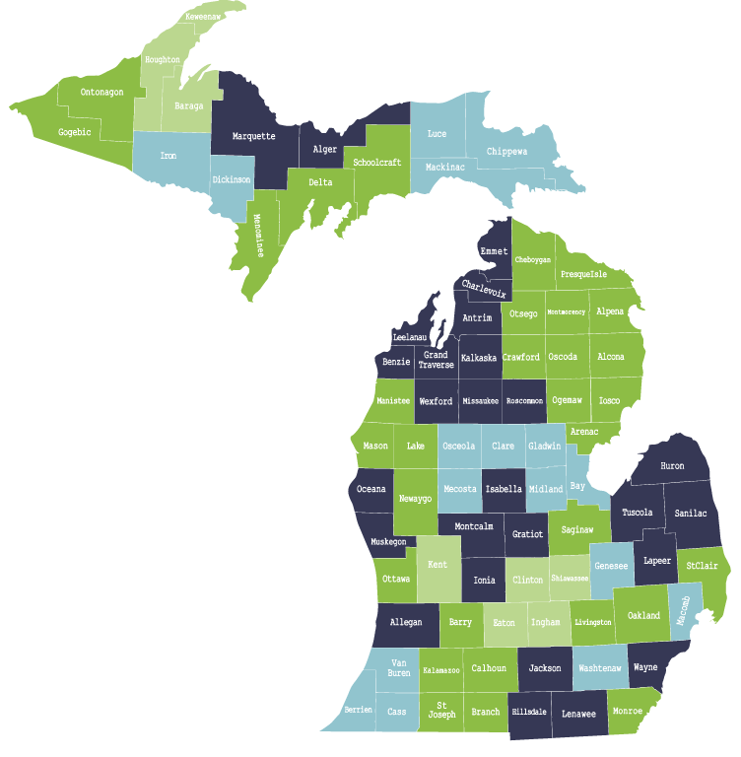
28 CAAs in Michigan
All Counties are covered
Most are Private Non-Profits
Represented by Michigan Community Action Agency
Northwest Michigan Community Action Agency, Inc. is a private, non-profit corporation recognized by the counties of Antrim, Benzie, Charlevoix, Emmet, Grand Traverse, Kalkaska, Leelanau, Missaukee, Roscommon, and Wexford as their Community Action Agency.

Slide 9

Community Action Promise
Community Action changes people’s lives, embodies the spirit of hope, improves communities, and makes America a better place to live.
We care about the entire community and we are dedicated to helping people help themselves and each other.

Slide 10
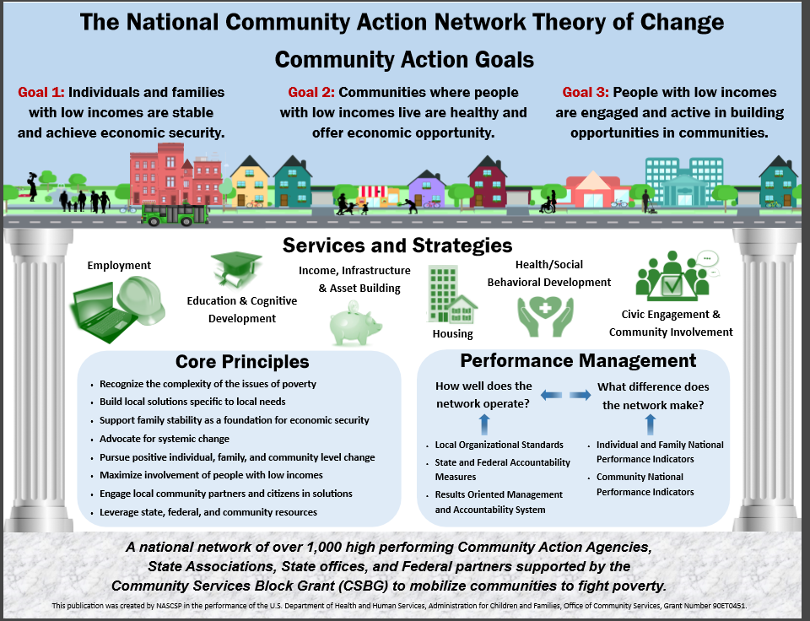

Slide 11

The corporation, Northwest Michigan Human Services Agency (NMHSA), was formed in April 1974 and is eligible to receive funding from Community Services Block grant in accordance with the Michigan Economic and Social Opportunity Act of 1981.
The agency was formed though a merger of One CAP (Missaukee, Roscommon, & Wexford) and Four CAP (Antrim, Benzie, Grand Traverse, Kalkaska, & Leelanau). Charlevoix and Emmet counties were added.

Slide 12

Mission Statement: Helping People by linking services, resources and opportunities.
Vision Statement: NMCAA leads in strengthening communities by empowering individuals to overcome barriers, build connections, and improve their quality of life.

Slide 13
Number of Employees Funding
1975: 24 $ 265,000
2020: 332 $24,868,077
Impressive Growth

Slide 14
NMCAA BOARD OF
DIRECTORS

Slide 15
Board of Directors
The governing Board
- is the Community Action Agency (CAA)
-legal director of the corporation
-sets Agency policy
-makes financial decisions

Slide 16
Board Composition
Community Services Block Grant (CSBG) Act requires administration by tripartite board:
1/3 (Public) Elected Officials
1/3 (Private) Members from the Community at Large
1/3 (Consumer/Target) Low Income
24 to 30 directors representing the public, private and consumer groups
Allows representation from each of the ten counties

Slide 17
Board Member Responsibilities
Maintain a structure for tending to the various aspects of the business for the organization
Represent the spirit of Community Action as expressed through the Purpose, Mission and Vision statements and their fulfillment to the greatest degree possible
Tend to legal responsibilities as prescribed by state statutes
ATTEND THE MEETINGS

Slide 18
Board Member Responsibilities
Appropriate social and personal behavior ranging from adequate preparation for meetings to questions of ethics and personal involvement
Make relevant policy decisions and oversee implementation of those decisions
Replacement of retiring Directors, introducing new Directors, and training of current Directors
Hold effective productive meetings where relevant information is processed in a timely fashion and high-quality decisions are made.
Comply with Board Member Code of Ethics

Slide 19
Code of Ethics
Adopted by the NMHSA/NMCAA Board of Directors on
October 16, 2003
Mirrors Code of Ethics from National Community Action Partnership
Themes:
Act in best interests of those we serve
Serve as a trustee of this organization
Adhere to proper duties and functions
Keep community informed
Positive Leadership
Service to the poor beyond service to oneself
High standards
Avoid conflicts of interest
Respect privileged information

Slide 20
Board Relationships
Executive Director is the employee of the Board of Directors
Share commitment to mission with staff, but play different roles
Appropriate communication encouraged, “back door” communication should be avoided
Further the NMCAA mission & goals through personal involvement / connections: Community, Boards, Legislative, etc.

Slide 21
III. NMCAA OVERVIEW

Slide 22
Current Configuration
Early Childhood Programs
Community Services
Food/Nutrition & Operations (IT, Support, Facilities)
Administration (E.D., Business Office, HR)

Slide 23
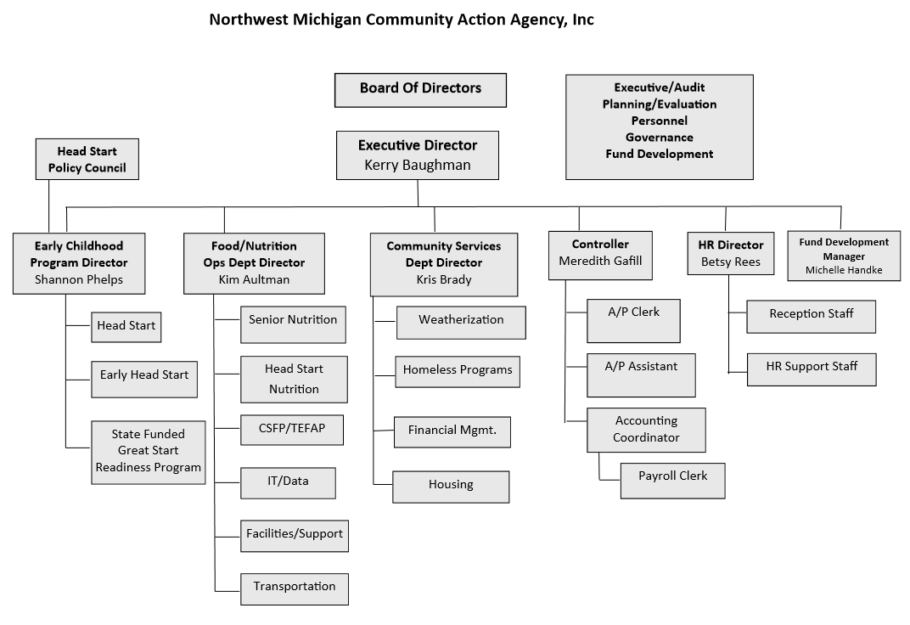

Slide 24
NMCAA Early Childhood Programs
Early Head Start (EHS)* 337
Serving expectant families and children to age three.
Home-based and childcare options
Head Start (HS)* 654
Serving preschool children three to five years in a classroom setting.
*Federally funding through the Office of Head Start within the Administration for Children & Families.
Eligibility is 100% for the Federal Poverty Level.
Great Start School Readiness Program (GSRP)** 120
Serving children four to five year in a classroom setting.
** State funded through the Michigan Department of Education. Eligibility is
Funded Enrollment Program Year 21-22 1,111 children and families served
Early Learning and Development Health Family Engagement

Slide 25
Head Start Requirements per the
Improving School Readiness for Head Start Act of 2007
Sharing of accurate and regular information with the Governing Board and the Head Start Policy Council
Monthly financial statements
Monthly program enrollment reports, including attendance
Monthly reports of meals and snacks provided by USDA
Financial audit
Annual self-assessment results
Community-wide strategic planning and needs assessment
of Head Start Agency
Communication and guidance from the Secretary

Slide 27
NMCAA Food Programs
Meals on wheels (Senior Nutrition)
The Meals on Wheels program is designed to deliver nutritious food to homebound seniors. Eligibility requirements; seniors 60 years of age and older, and homebound for home delivery.
Counties served by NMCAA: Grand Traverse, Leelanau, Missaukee, Wexford
commodity supplemental food program (csfp)
CSFP is a USDA program that provides a 40–45-pound package of food each month to nutritionally at-risk senior citizens. Eligibility requirements; seniors 60 years of age and older, income below 130% of poverty.
the emergency food assistance program (tefap)
TEFAP provides USDA food to low-income households through a quarterly distribution. Eligibility requirements; households under 60 years of age – income under 130% of poverty, households over 60 years of age – income under 160% of poverty.

Slide 29
NMCAA Community Services
weatherization
The Weatherization Program provides free energy conservation services to eligible low-income households in NMCAA’s ten-county service area.
Eligibility is set according to 200% of poverty income guidelines.
Homes are evaluated for attic, sidewall, and foundation insulation. Blower Door tests are done on each home to determine air infiltration points and how they will be sealed. All Combustion appliances (furnace, water heater, stove, and dryer) are tested for safe operation.
housing rehab/development and community development
NMCAA is involved in numerous housing improvement and development activities including:
Community Development Block Grant Program Income Home Rehabilitation in Antrim, Benzie, Charlevoix, Grand Traverse, Kalkaska, Missaukee, and Wexford Counties
Rural Development Housing Preservation Grant program for home repairs
Affordable Housing for Rural Veterans Rehab Program
MSHDA HOME Grant for Homeowner Rehab in Grand Traverse and Wexford Counties
Cherryland Cares Grant for Homeowner Rehab
NeighborWorks Safe and Sound Grant for home repairs

Slide 30
NMCAA Community Services
Community Services provides direct services to low-income residents to promote self-sufficiency and works with communities to ensure healthy environments where all residents can thrive.
homeless prevention services
Community Services Homeless Prevention programs address the immediate shelter and housing needs of those who are homeless and are at imminent risk of homelessness, including:
NMCAA serves as the Housing Assessment and Resource Agency (HARA) for Antrim, Benzie, Charlevoix, Emmet, Grand Traverse, Kalkaska, Leelanau, Missaukee, and Wexford Counties.
Salvation Army/DHHS Motels for Shelter Overflow program
Emergency Solutions Grant (ESG)
HUD and DHHS Rapid Rehousing Programs for the general population (Charlevoix, Emmet, Missaukee, Manistee, and Wexford Counties)
US Veterans Administration Supportive Services for Veteran’s Families Program for 23 counties
HUD Rapid Rehousing for Homeless Youth & Pregnant and Parenting Youth
HUD Coordinated Entry Program & Youth Diversion Program
COVID Relief programs:
  ESG Rapid Rehousing, CRF Eviction Diversion Program, Coronavirus Emergency Rental Assistance

Slide 31
NMCAA Community Services
financial management services
Financial Management Services is a HUD and NeighborWorks Certified program that provides counseling and education as well as financial assistance to help consumers gain and maintain financial independence through the following programs:
Basic household budget counseling
Financial Coaching & Case Management (debt management, credit repair, education,
Savings/future planning, etc.)
MSHDA Housing Choice Voucher Family Self-Sufficiency Program
Individual Development Accounts (IDA)-matched savings accounts for specific asset purchase
Free Income Tax preparation
Bankruptcy Counseling and Education
eHome America Homebuyer’s Ed and eMoney Financial Capability online workshops
crisis intervention
Community Services staff receives thousands of customer calls and walk-ins each year for which they do initial assessments and provide direct crisis services to help those in need which include:
Information and Referral
Emmet County Utility Pool Seasonal Emergency Utility Assistance including:
  -MEAP Utility Assistance, Blarney Castle Fuel Fund, Community Services Gap Fund
Community Crisis Response

Slide 32
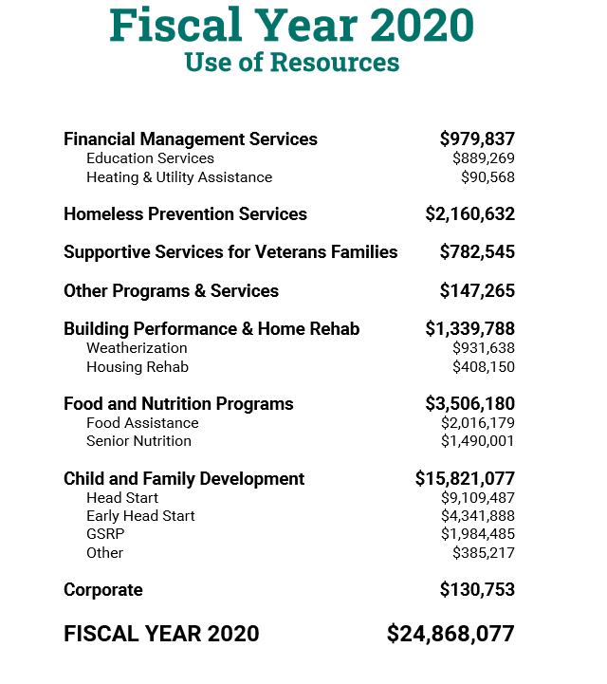
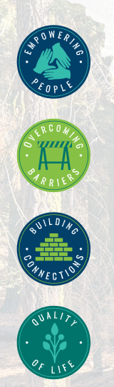

Slide 33
IV. OPERATIONS PLANS/ROMA

Slide 34
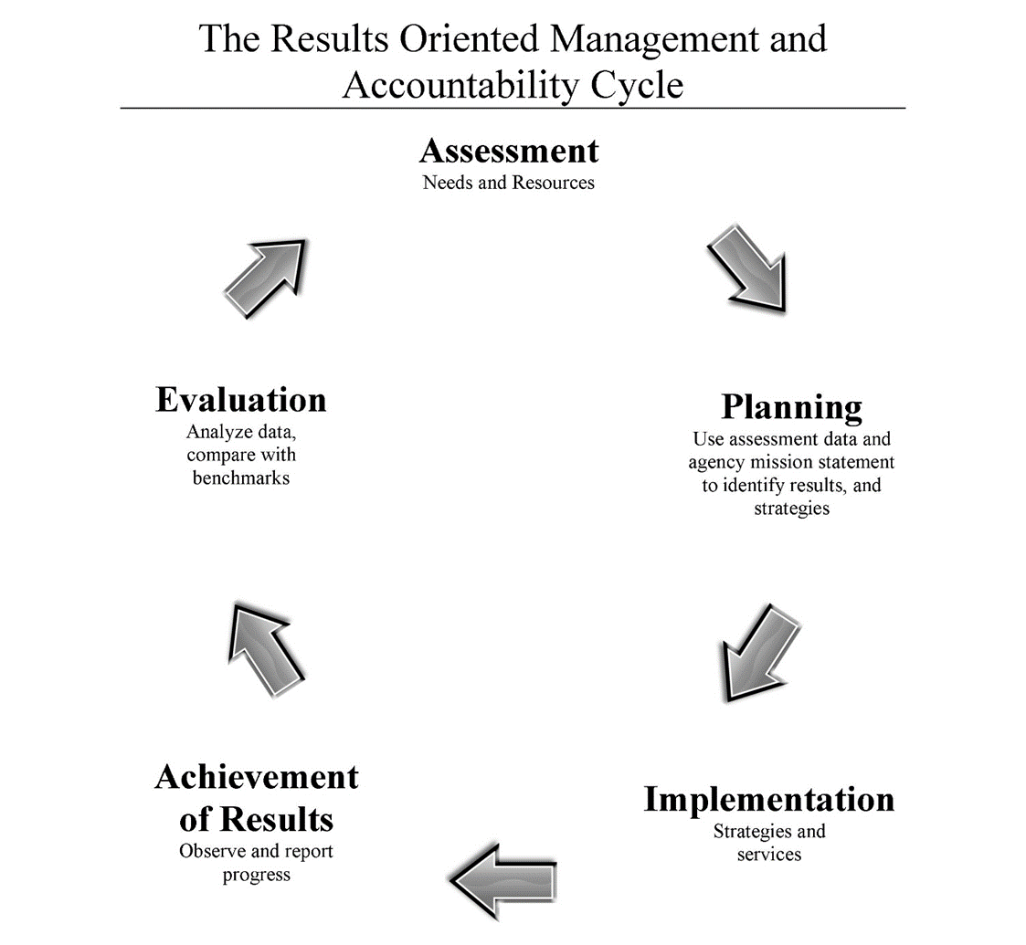
Operations Plan / ROMA Progress Report
(Monthly by Department)
Results Oriented Management and Accountability: a performance-based initiative designed to preserve the anti-poverty focus of community action and to promote greater effectiveness among state and local agencies receiving Community Services Block Grant (CSBG) funds.

Slide 35
Operations Plan / ROMA* Progress Report
Grant Contract name
Total Grant Amount
ROMA Service or Outcome Goal Statement(s)
FY Goals completed this month & year-to-date
Expenditures this month, Year-to-date, and balance
% of total grant funds spent
% goals completed

Slide 36
NMCAA & Current Realities
Funding Uncertainties
High quality operations at all levels; excellent reputation
Over 170 grants & contracts, braided together to provide strong, broad mix of services
Must restructure access and practices for across-the-board service bundling
Must further diversify revenue streams with systematic fundraising,
AND complete culture-shift as a Culture of Philanthropy
Ramp up Housing Development
Friends and ambassadors to better tell the story

Slide 37
Summary
Please review this handout, the NMCAA By-Laws, the Code of Ethics, your Board Books, and the Executive Director’s Monthly Report Presentation
Everything is on the website: www.nmcaa.net =>About Us => Board of Directors
More information always available!
NMCAA main office: 800.632.7334 or 231.947.3780
Kerry’s direct office line: 231.346.2061

